Slide 1
Dimensionality Reduction and Clustering Tools for High Parameter Discovery
BY MY
20211025

Slide 2
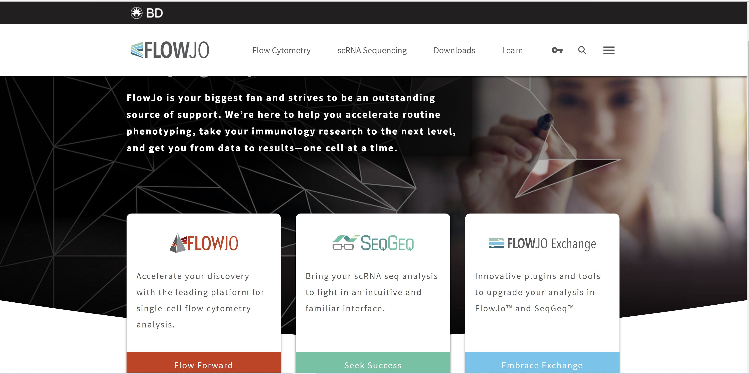

Slide 3
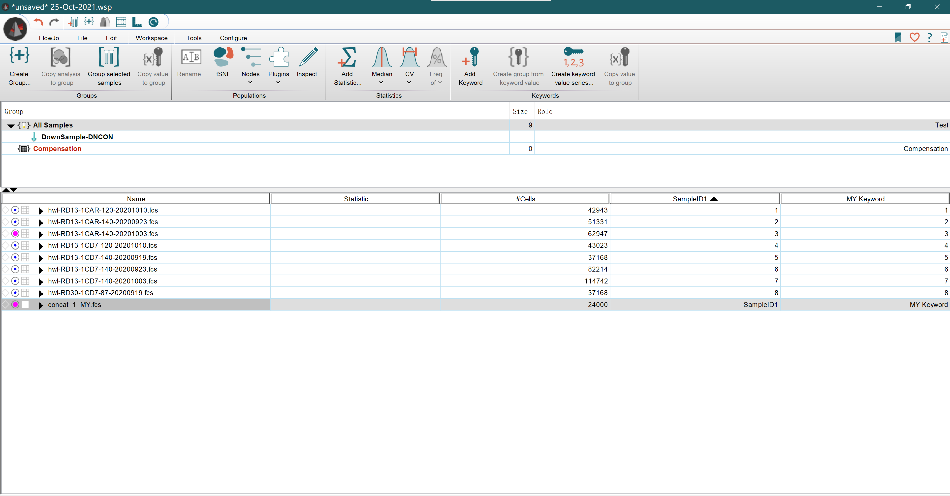

Slide 4
Flowchart
QC
Compensation
Gating
Visual.
Advanced Ana.

Slide 5
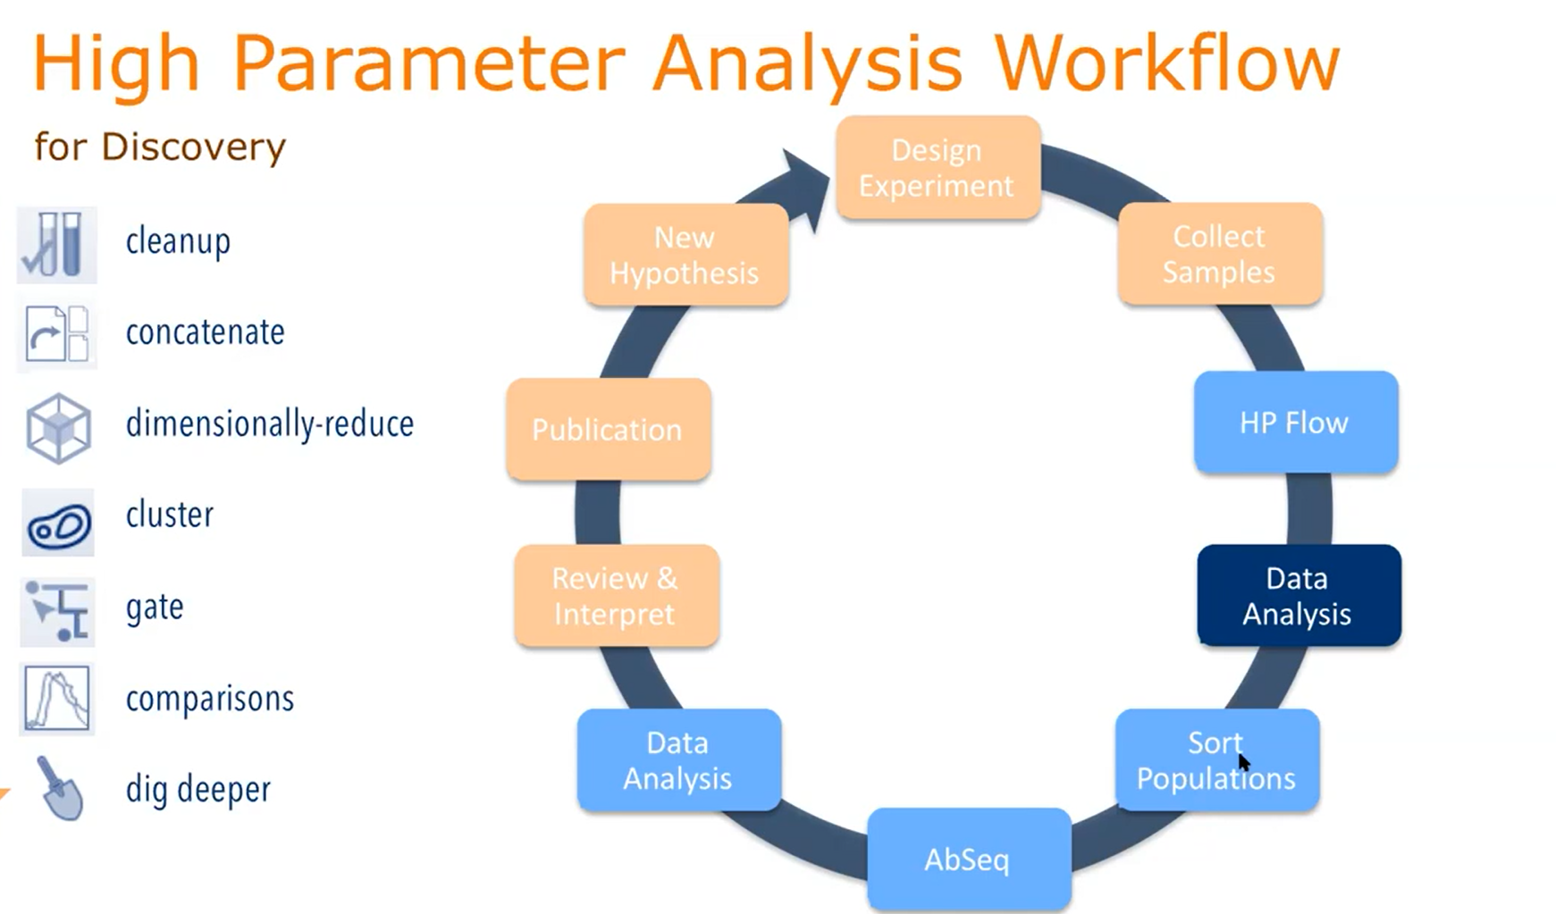
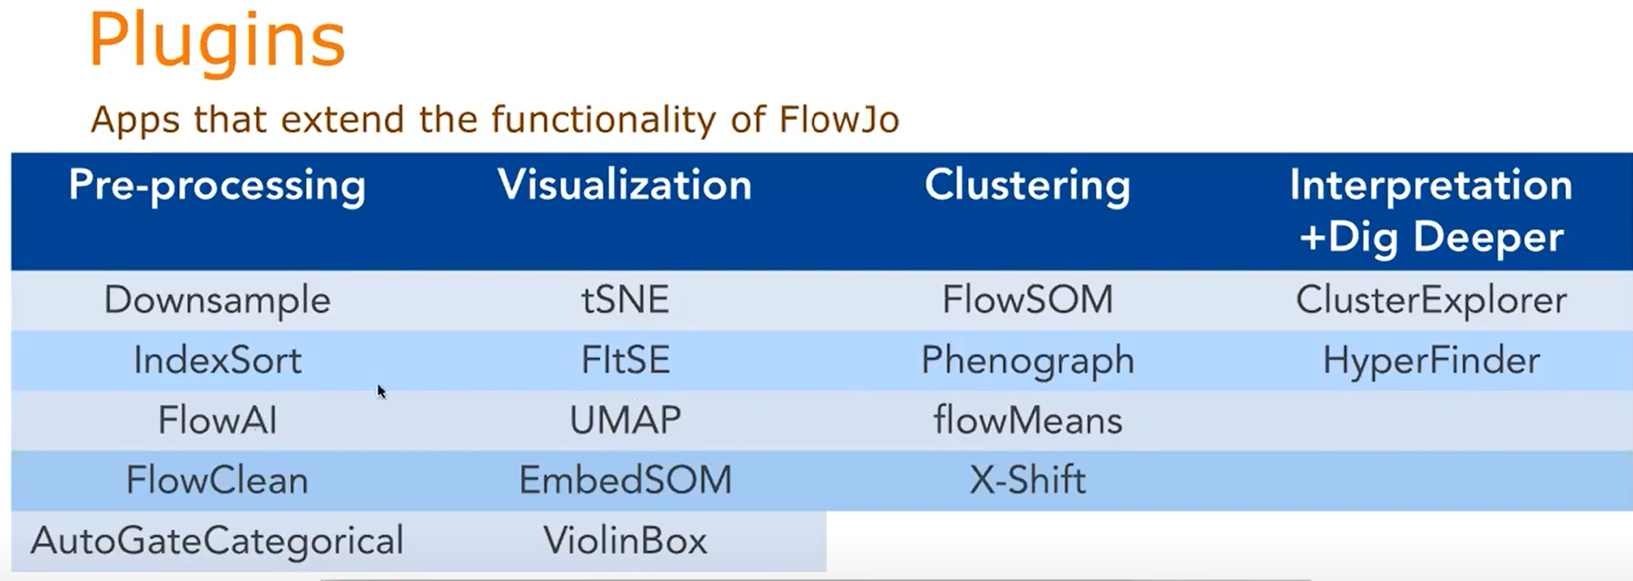

Slide 6
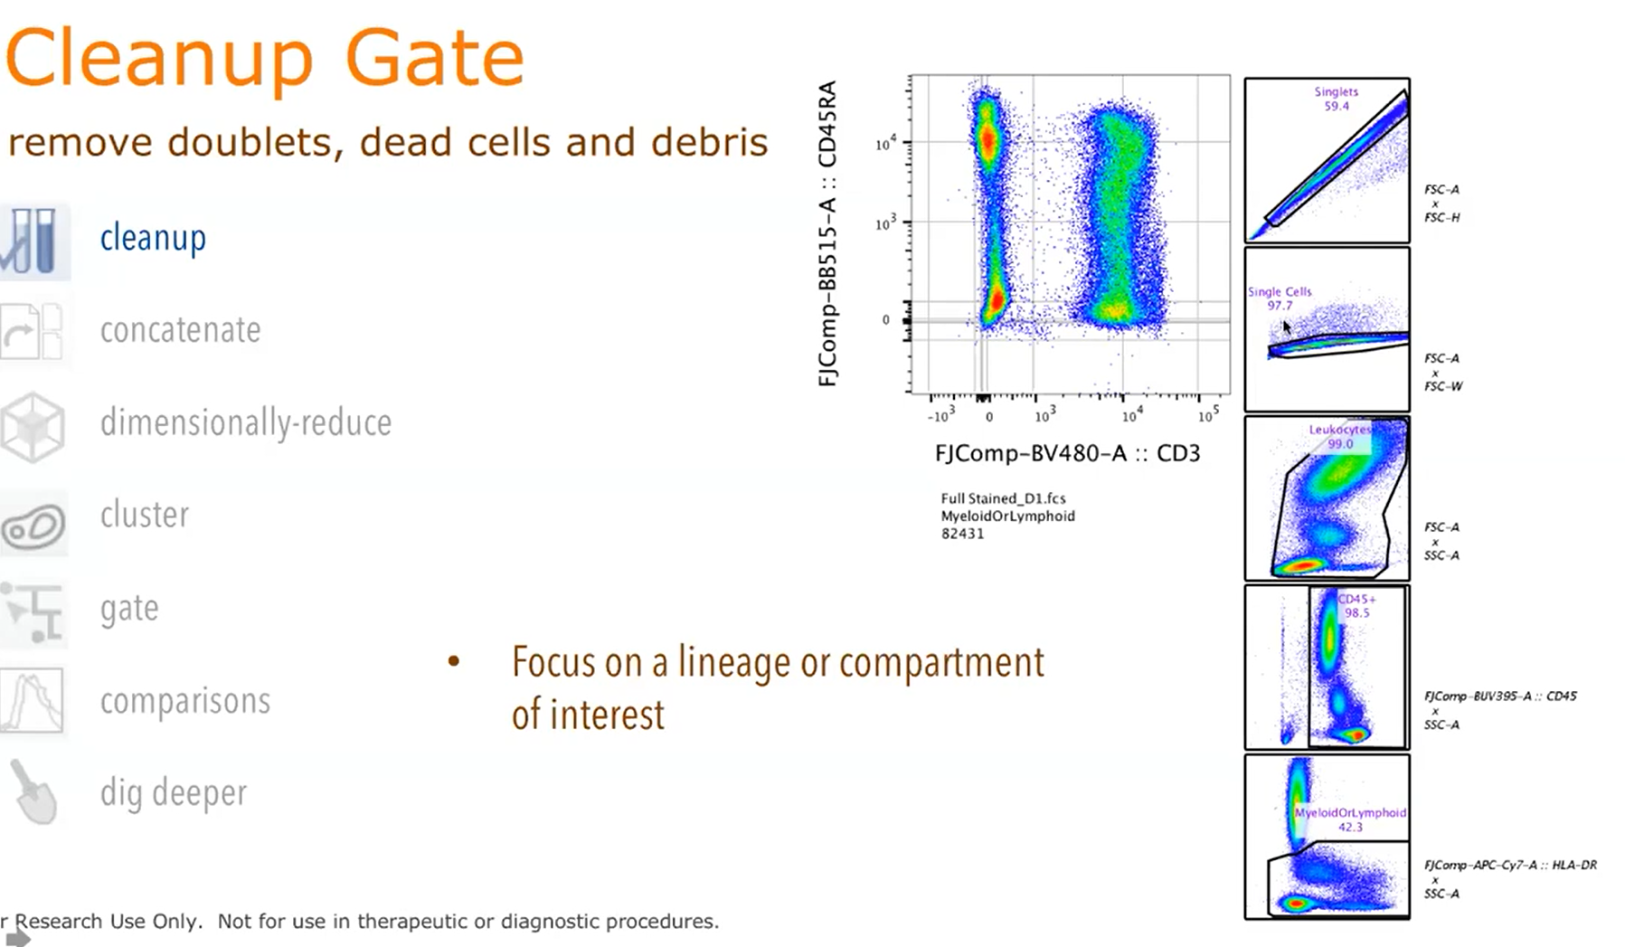

Slide 7
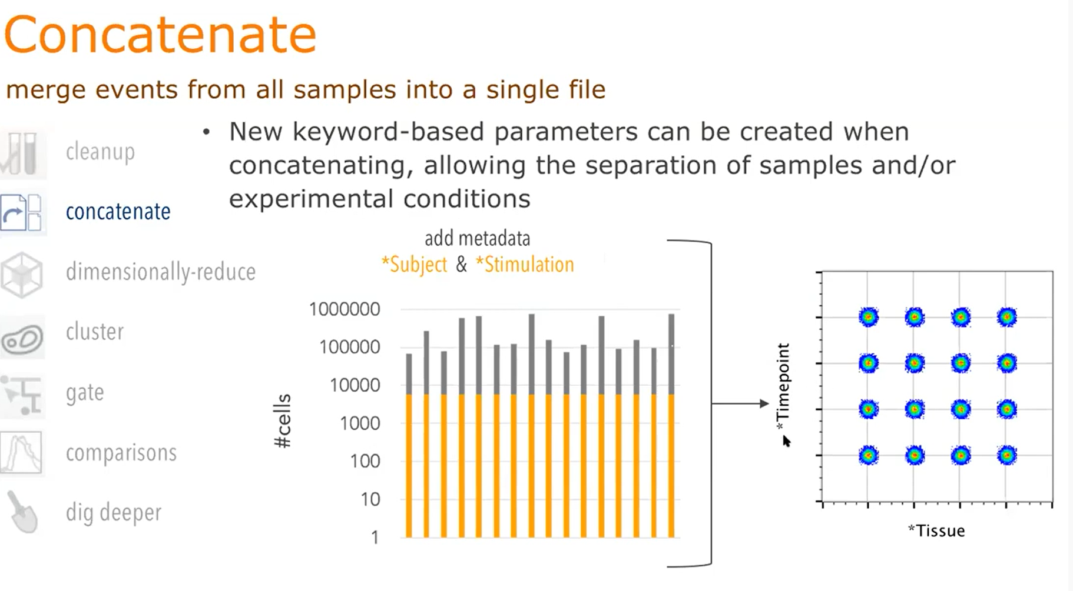
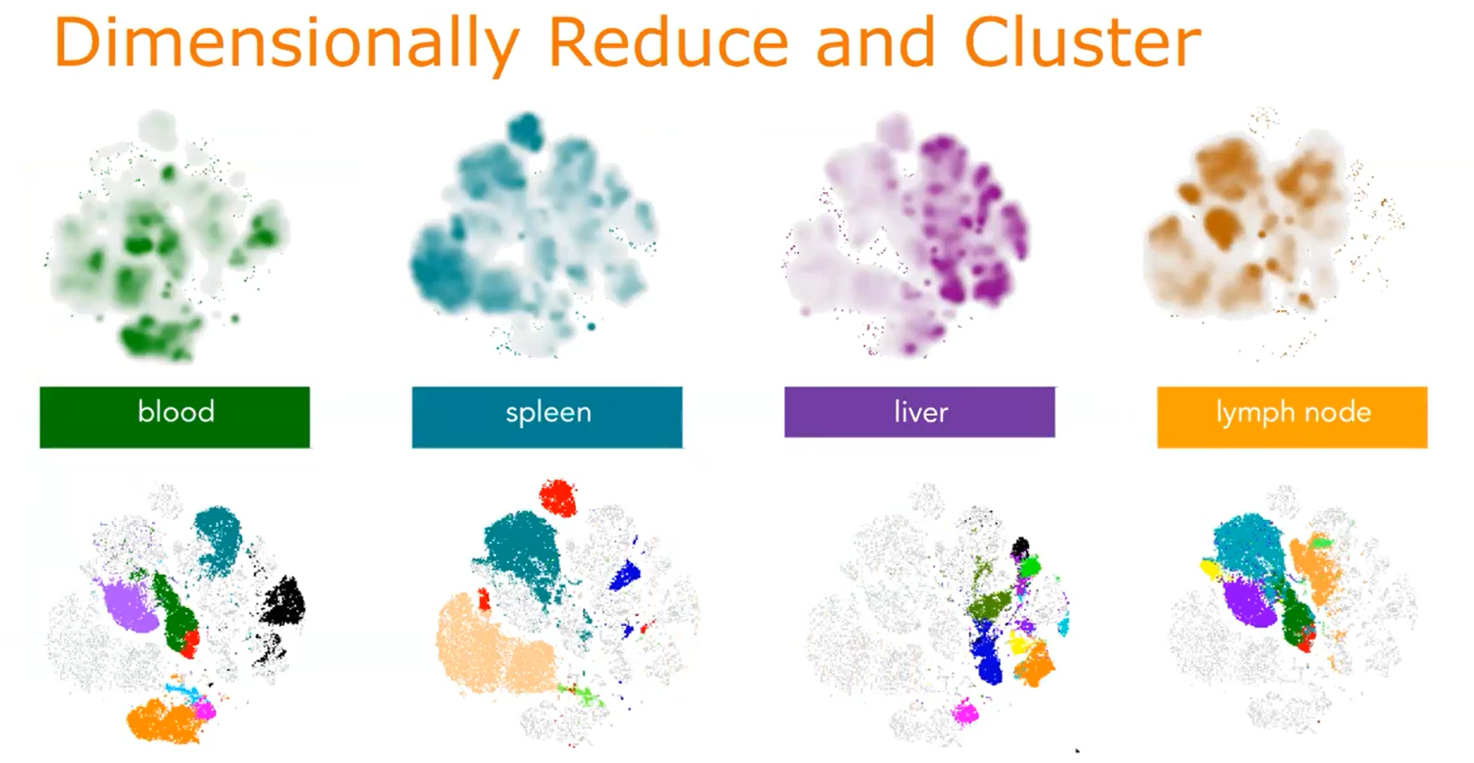
https://docs.flowjo.com/flowjo/workspaces-and-samples/samples-and-file-types/ws-export/

Slide 8
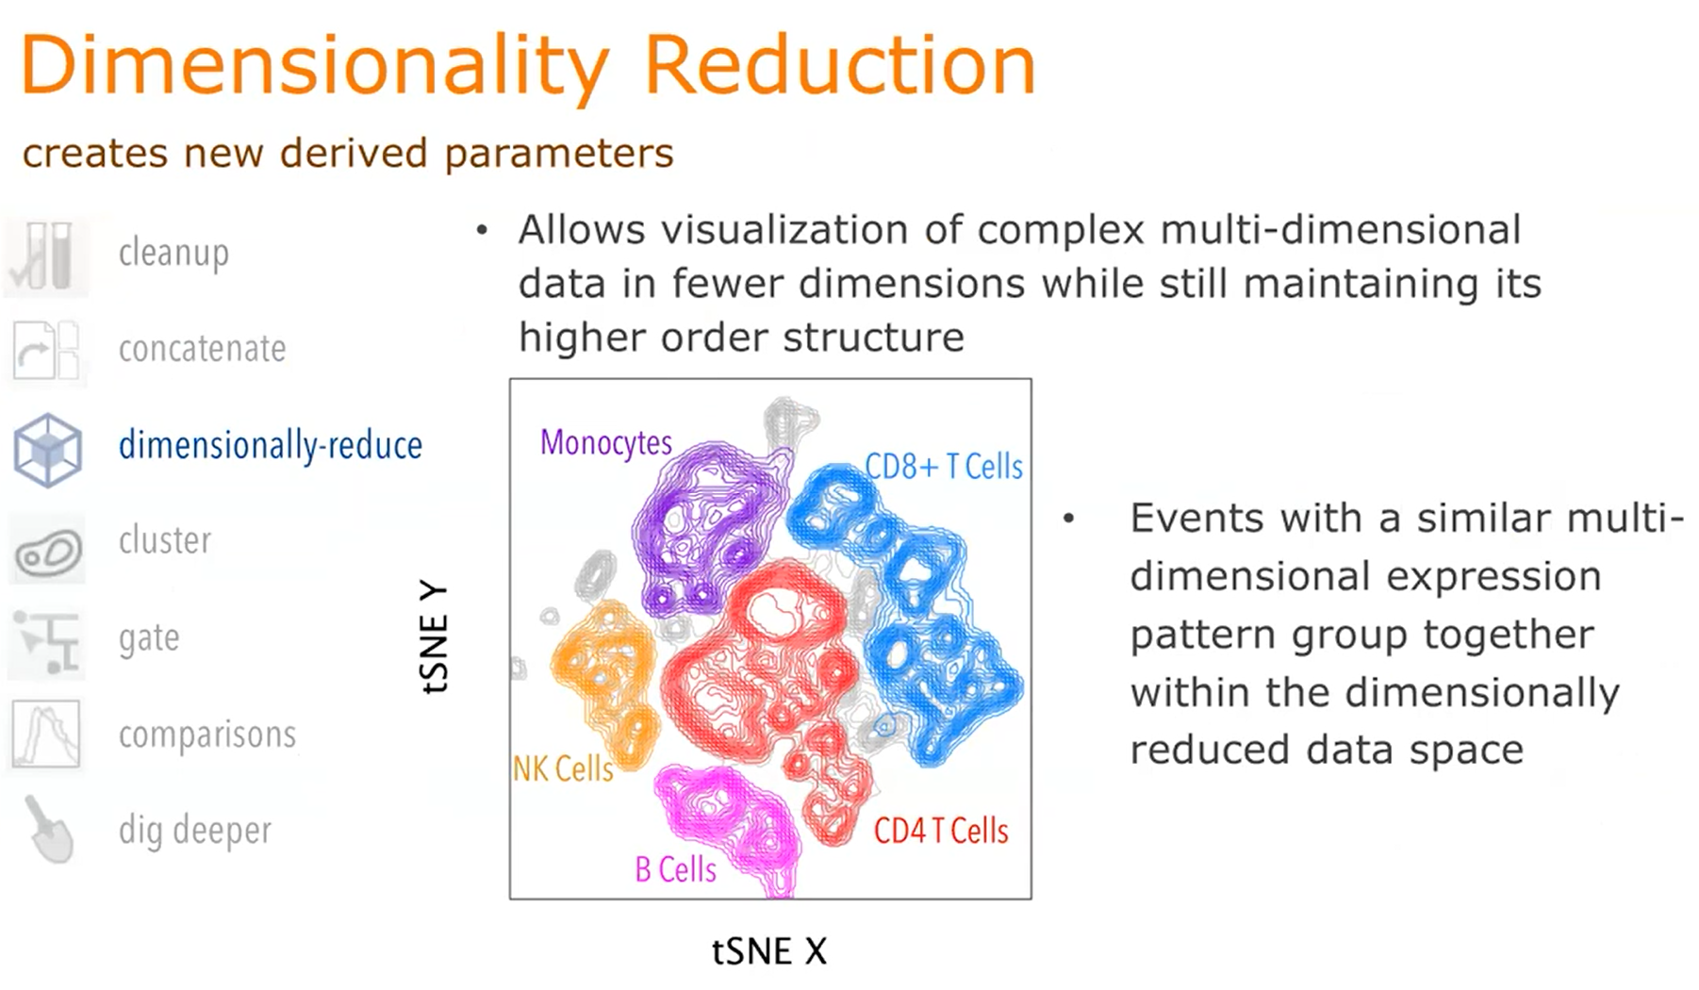

Slide 9
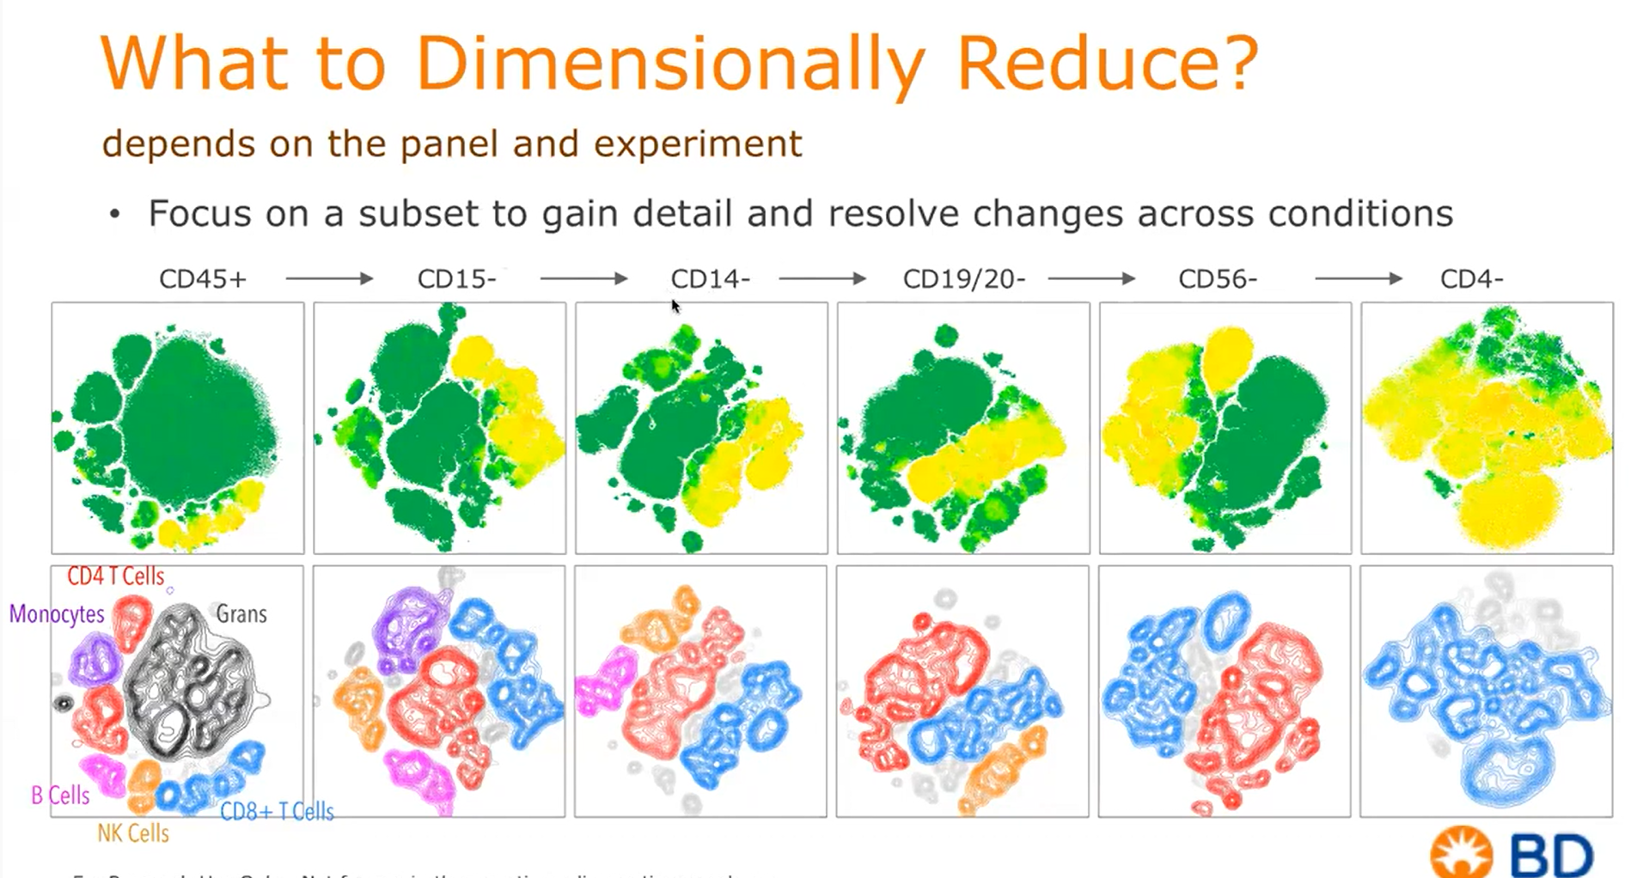

Slide 10
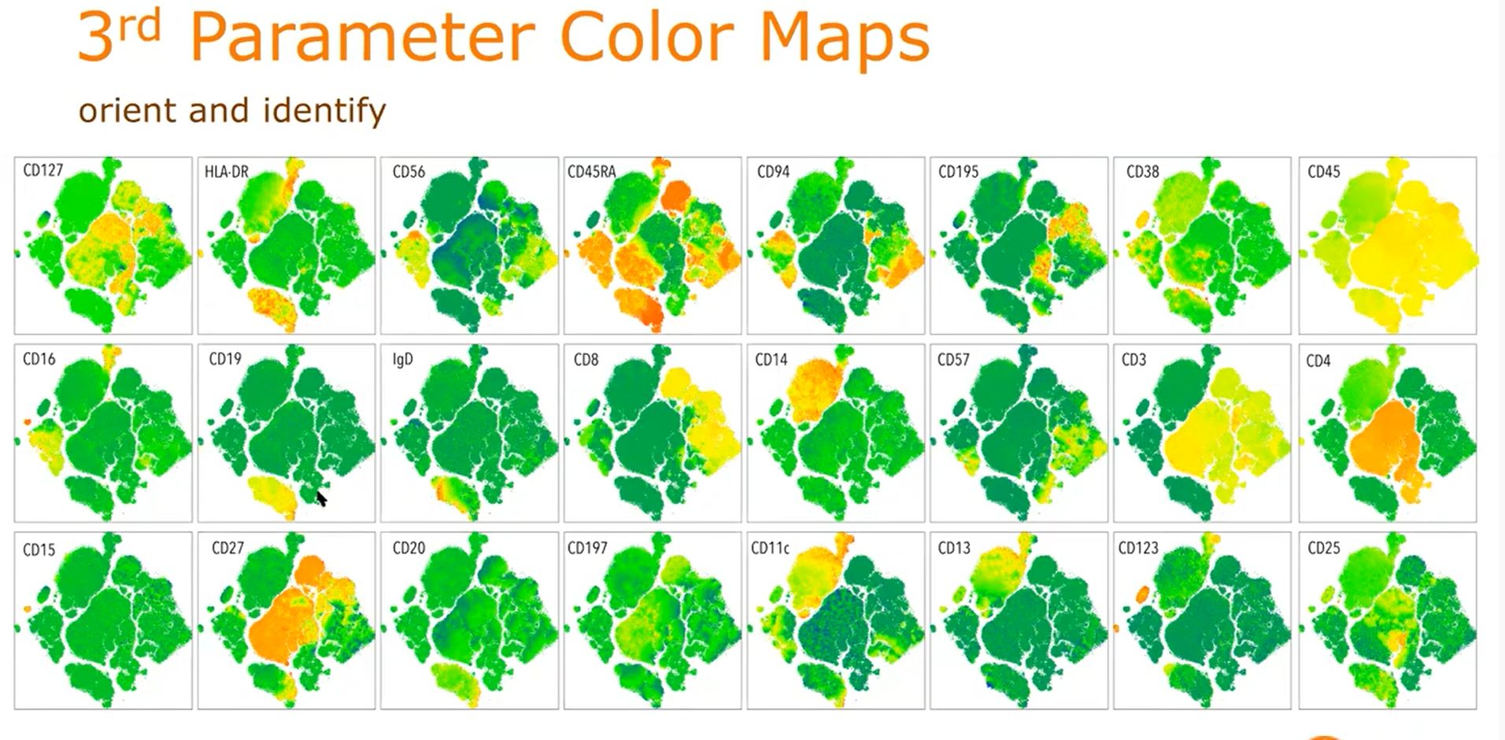

Slide 11
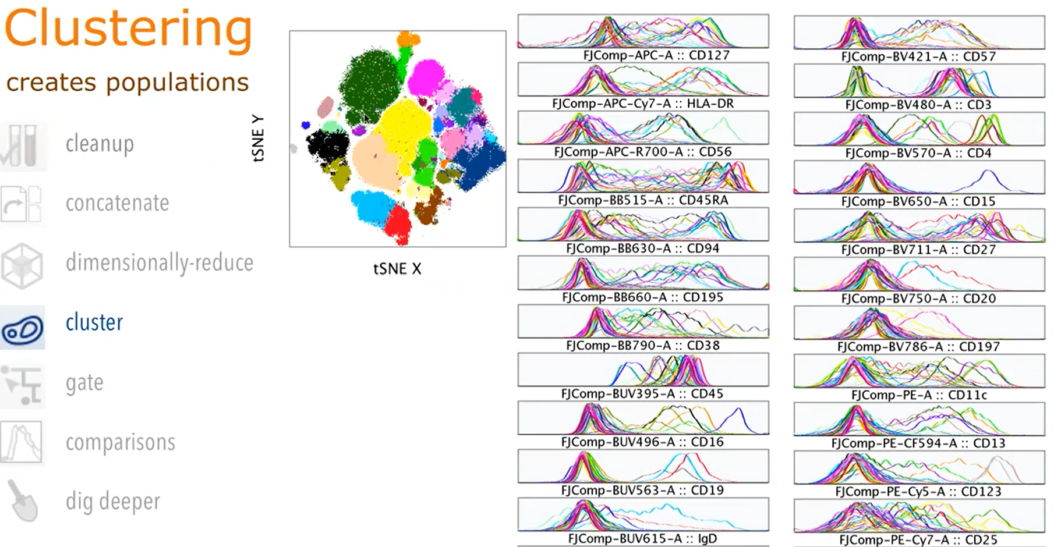

Slide 12
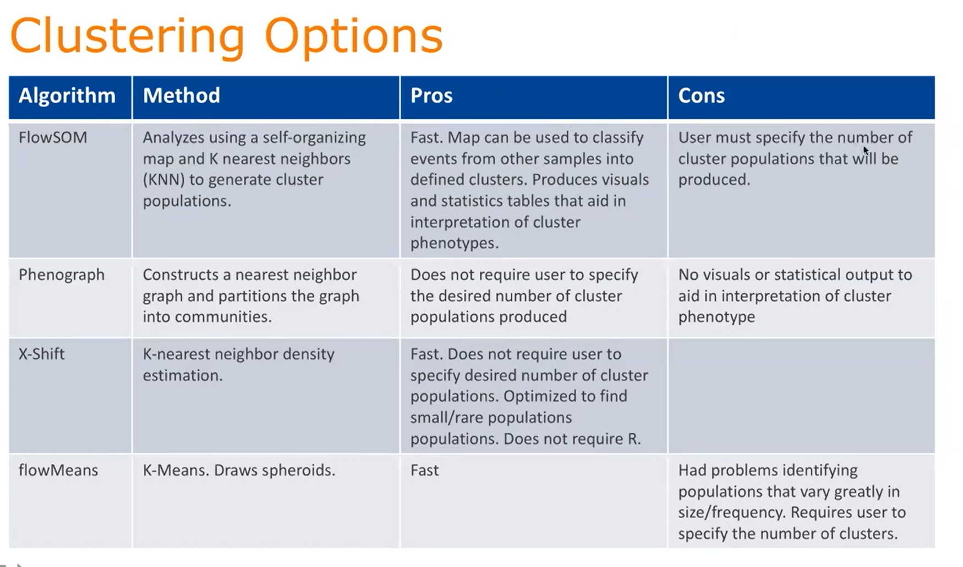

Slide 13
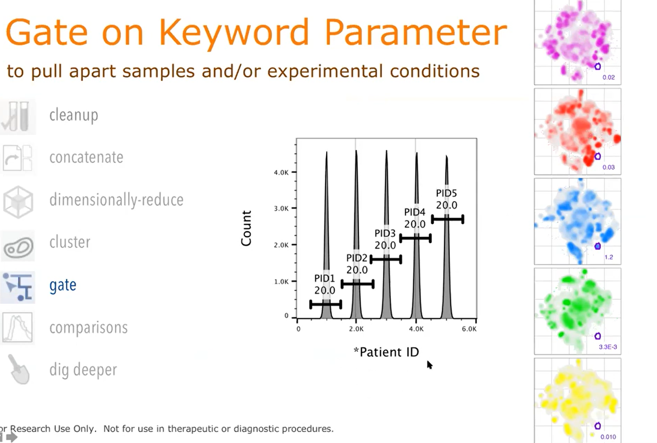

Slide 14
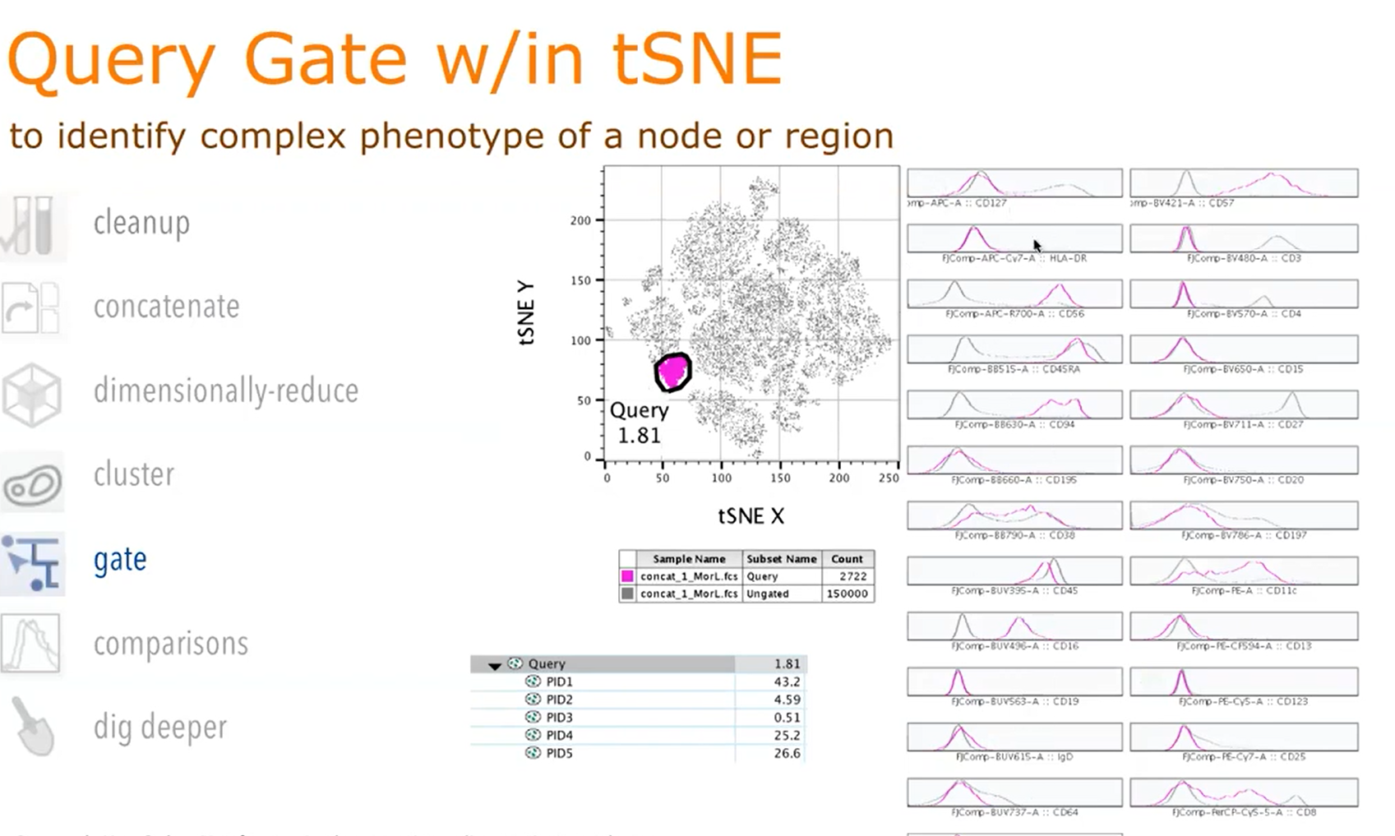

Slide 15
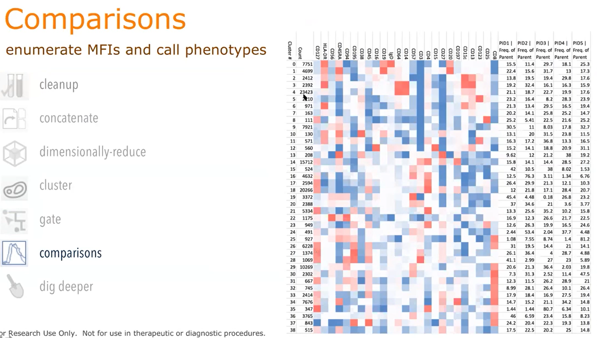

Slide 16
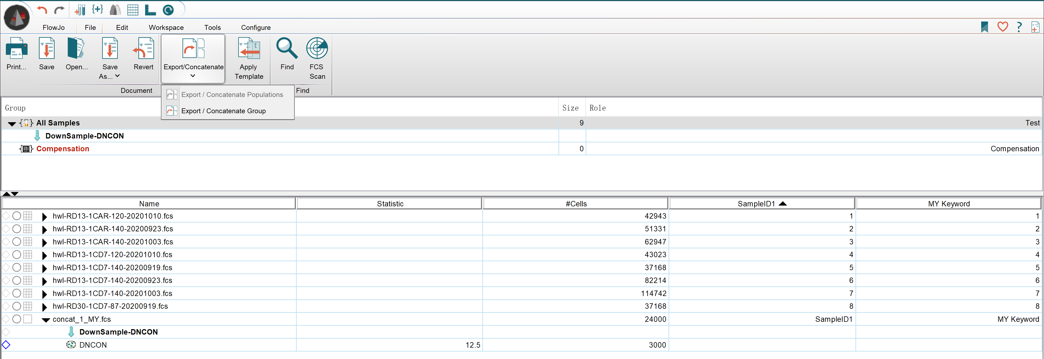
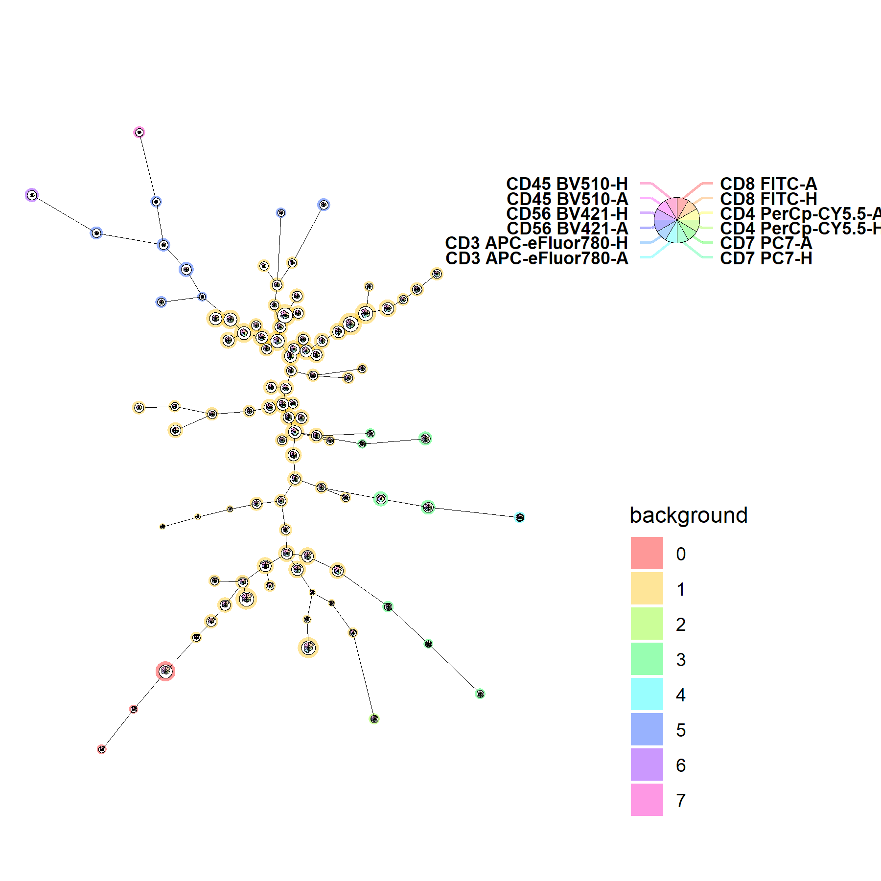
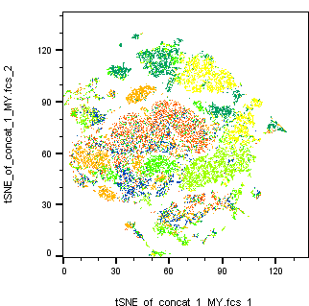
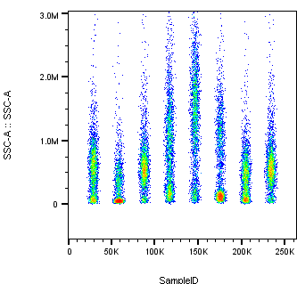

Slide 17
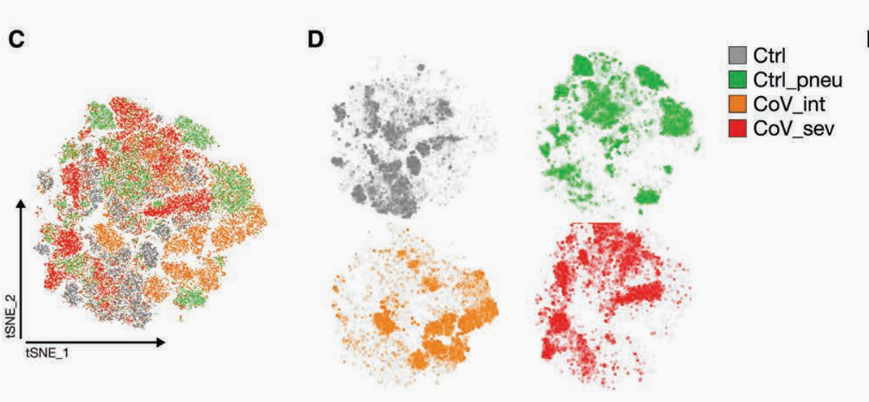
Immunothrombotic Dysregulation in COVID-19 Pneumonia Is Associated With Respiratory Failure and Coagulopathy（2020）DOI:10.1161/CIRCULATIONAHA.120.048488

Slide 18
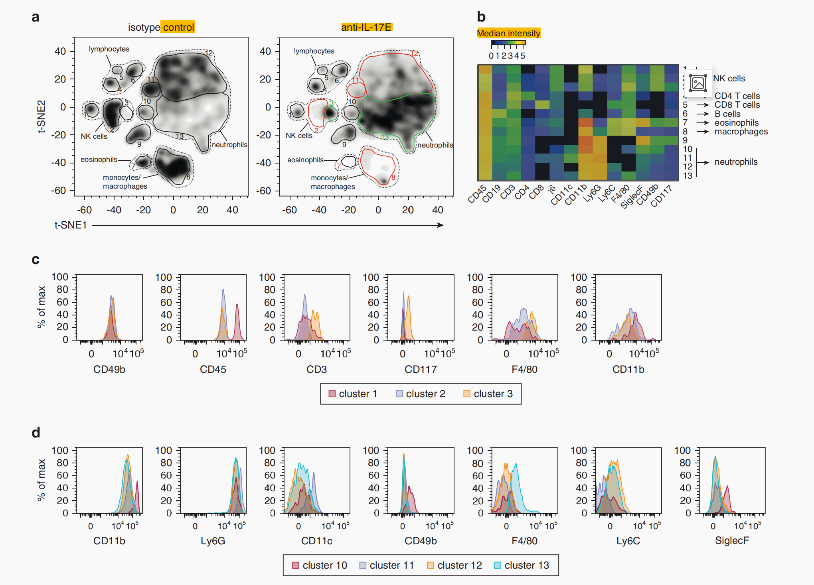
tSNE（t-Distributed Stochastic Neighbor Embedding）降维-圈选细胞亚群查看分子表达情况
mean flfluorescence intensity of the indicated markers in each cell cluster
IL-17E (IL-25) Enhances Innate Immune Responses during Skin Inflflammation （2019） doi:10.1016/j.jid.2019.01.021

Slide 19
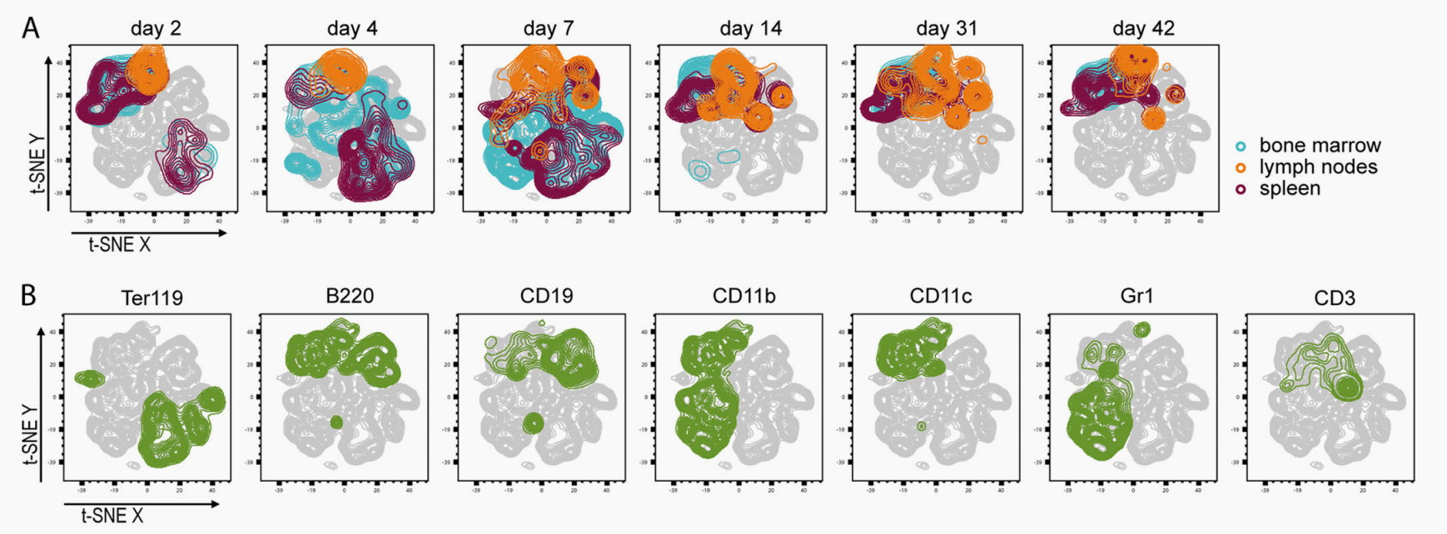
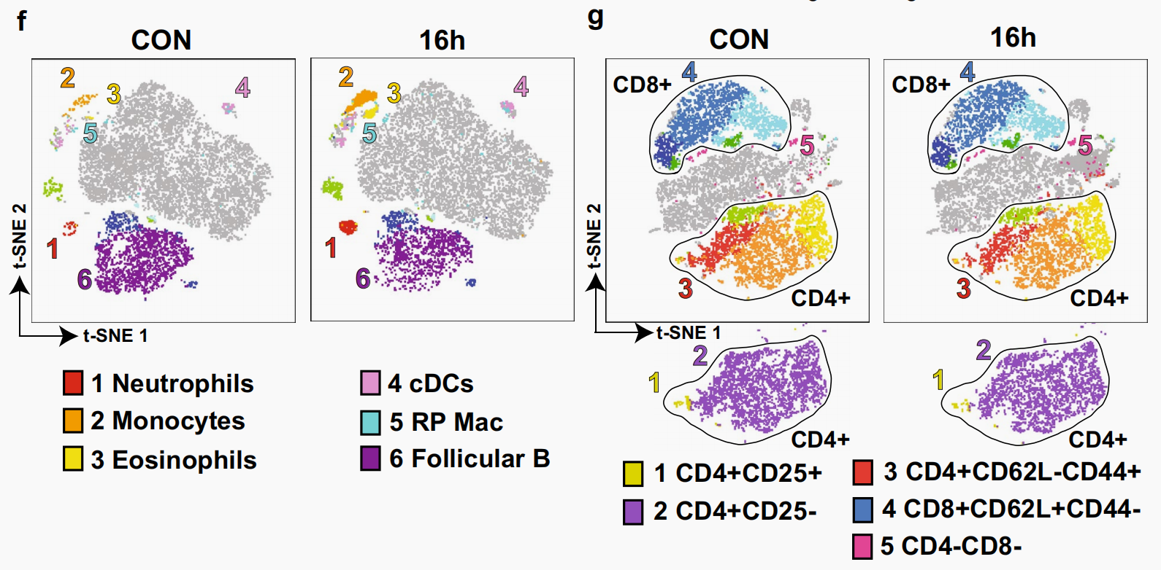
Infection of B Cell Follicle-Resident Cells by Friend Retrovirus Occurs during Acute Infection and Is Maintained during Viral Persistence（2019）doi.org/10.1128/mBio.00004-19.
Characteristic pancreatic and splenic immune cell infltration patterns in mouse acute
Pancreatitis (2021) doi.org/10.1186/s13578-021-00544-1

Slide 20
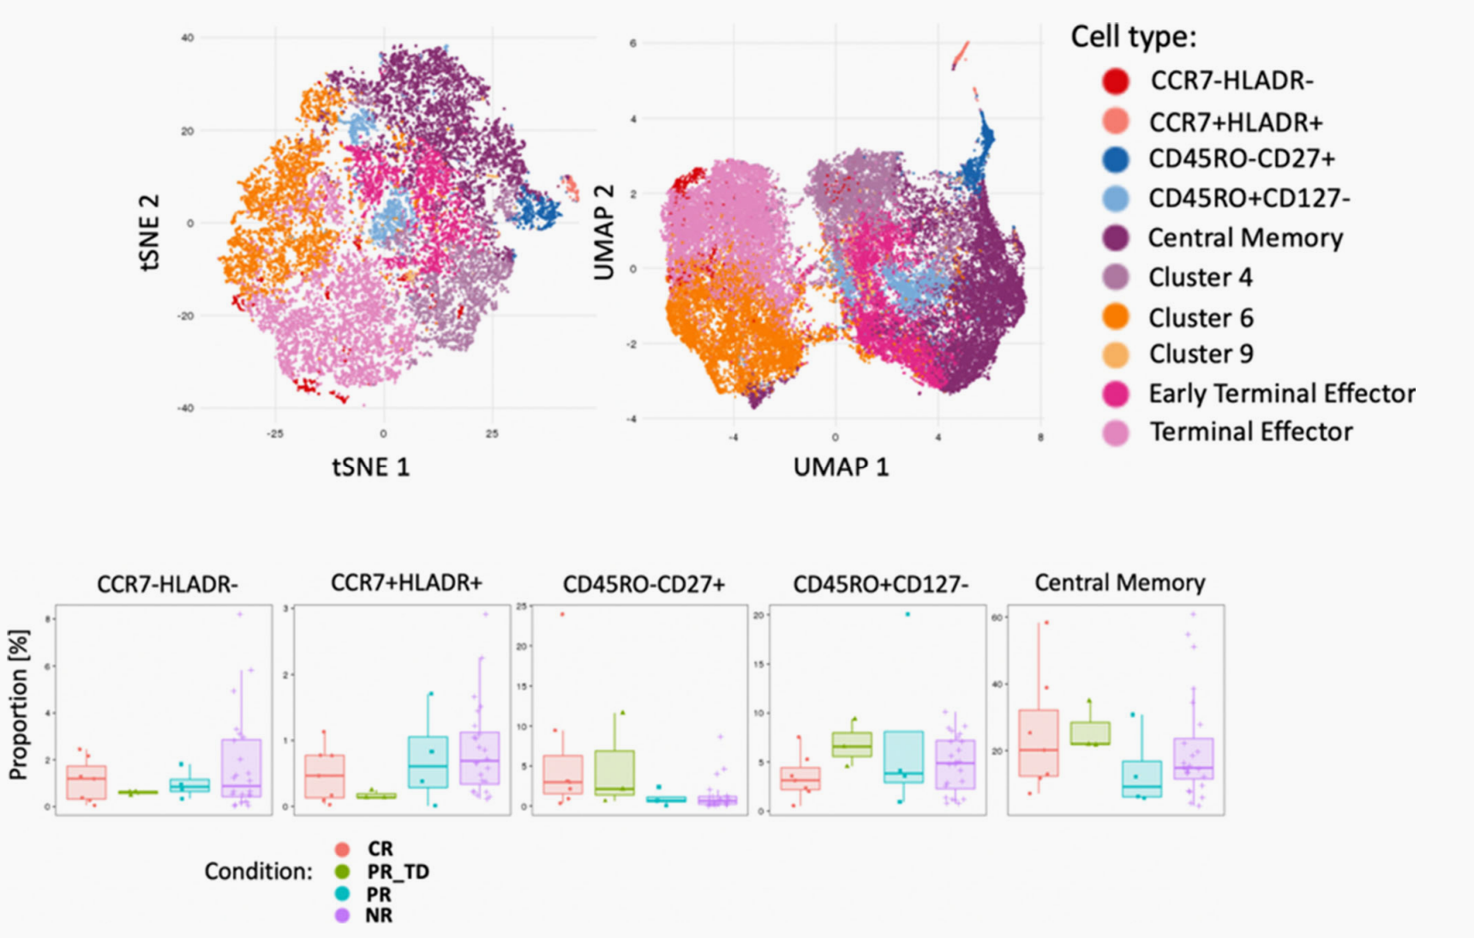
Basic of tSNE
---Dimensionality reduction algorithm ----nonlinear data
---Generates islands of phenotypically similar cells
---Purposes：
Visualize general structure
Show heterogeneity of samoles
https://docs.flowjo.com/flowjo/advanced-features/dimensionality-reduction/tsne/ (Introducton)

Slide 21
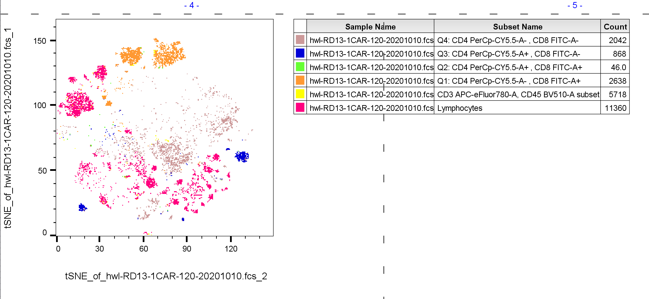
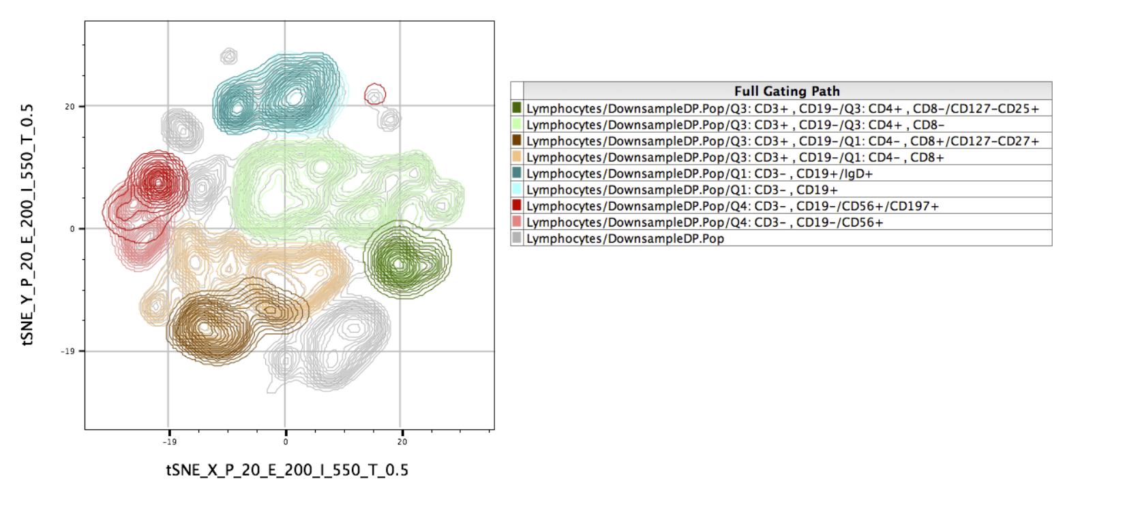

Slide 22
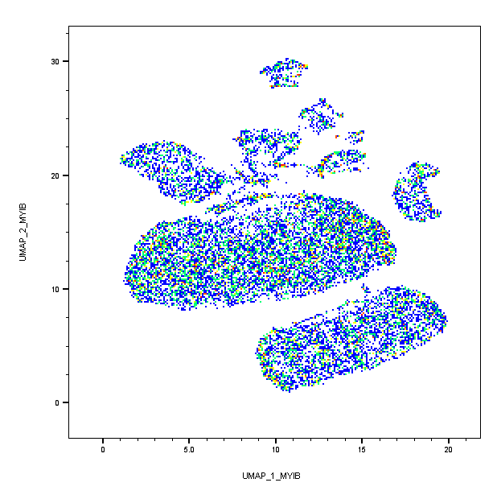
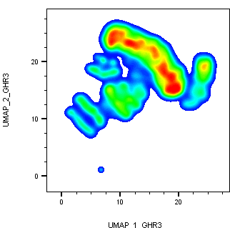
UMAP
Dimensionality Reduction | FlowJo Documentation - Documentation for FlowJo, SeqGeq, and FlowJo Portal

Slide 23
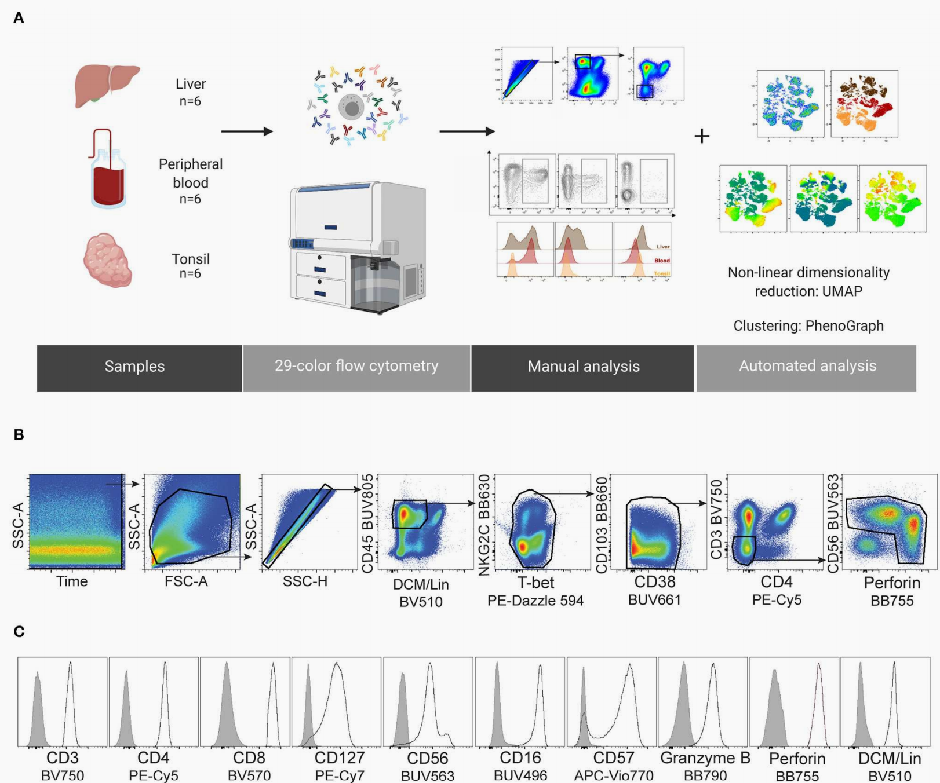
29-Color Flow Cytometry: Unraveling Human Liver NK Cell Repertoire Diversity (2019) doi: 10.3389/fifimmu.2019.02692

Slide 24
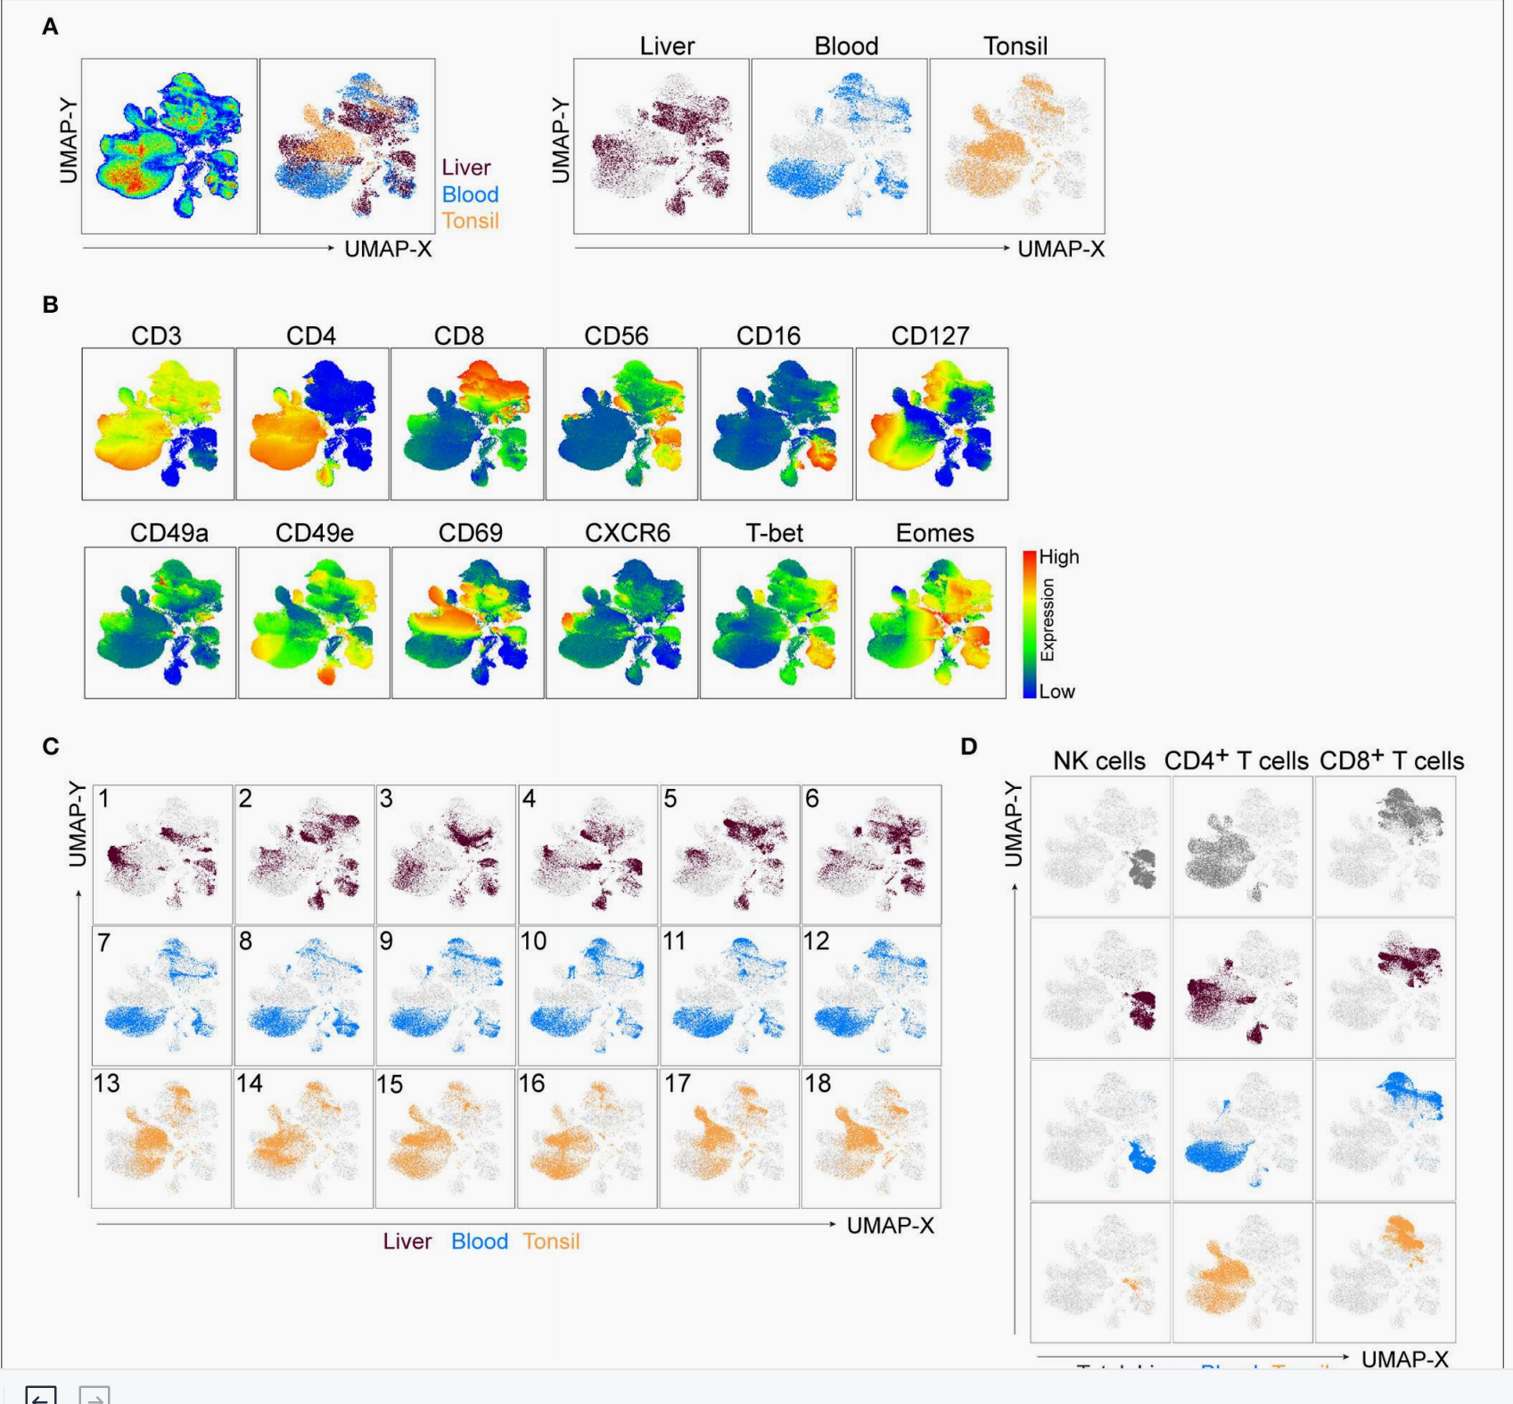
29-Color Flow Cytometry: Unraveling Human Liver NK Cell Repertoire Diversity (2019) doi: 10.3389/fifimmu.2019.02692

